Slide 1
Databases
Utah’s Online Databases: magazine, journal, newspaper, & encyclopedia articles
Search Engines: Free personal & commercial web pages, current news & information; government information; advertisements; chat rooms, newsgroups, listservs

Slide 2
Review Process
Utah’s Online Databases:
Information comes from publishing groups and goes through a review process. Publisher’s editors check the information for accuracy and reliability.
Gale Reference Collection

Slide 3
Vetted defined
Vetting is a term used to refer to a site that has been reviewed for accuracy.
To verify, check for accuracy, or conduct a thorough examination or evaluation.
“An expert vetted the manuscript before publication.”

Slide 4
Peer Review
Peer review means the article has been reviewed by people that work in the same profession or field.
Evaluation of a person’s work by a group of experts before it is published to make sure it meets the necessary standards.
The purpose of peer review is to ensure that it is quality work.

Slide 5
Evaluation
Search Engines: no one owns or controls the Internet, information does not go through a review process. Anyone can publish an opinion regardless of authority, education or experience with the subject. Web pages should be carefully evaluated for accuracy and reliability.
C.R.A.A.P. is an easy device, or mnemonic, to help you remember the following evaluation criteria:
C - Currency
R – Relevancy
A - Accuracy
A - Authority
P - Purpose

Slide 6
Scholarly usually refers to journals such as
Image taken from http://pubs.acs.org/
action/showLargeCover?issue=33036239
Image taken from http://jama.ama-assn.org/content/
295/15/1860.full

Slide 7
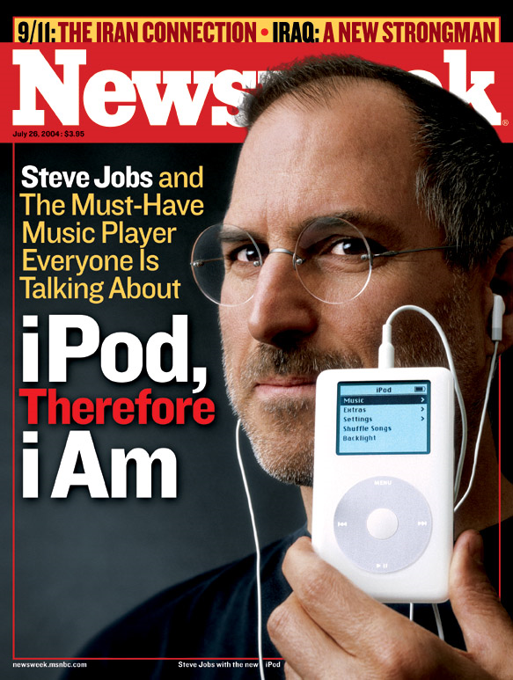
Popular usually refers to magazines such as
Image taken from http://www.time.com/time/covers/0,16641,1101110131,00.html
Image taken from http://static.seekingalpha.com/uploads/
2010/4/4/saupload_040717_cover.jpg

Slide 8
Summing Up
Both scholarly and popular articles can be used in research, but be aware of the characteristics and quality of each.

Slide 9
The three Boolean operators are:
AND
OR
NOT
Boolean operators are used to expand or limit the number of results in a search.

Slide 10
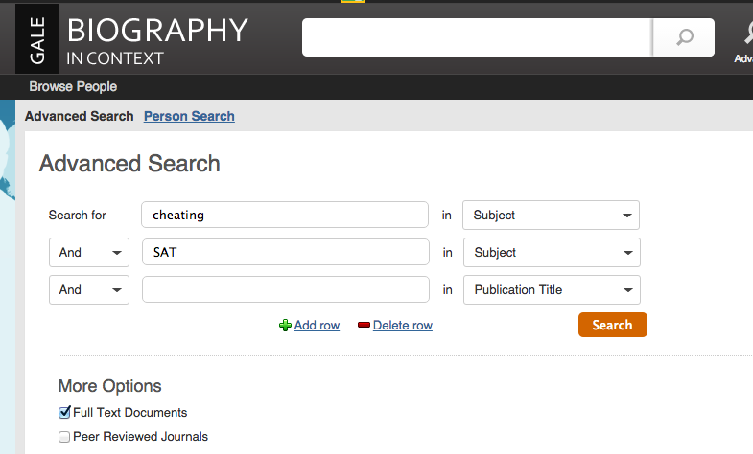
For example, GALE Biography uses them to perform advanced searches.
Here the AND Boolean Operator is being used to find articles that deal with both cheating and SAT.

Slide 11
JHS Library
JHS High School- jhs.canyonsdistrict.org
Webpath = Database of website
Several databases searched all at once through library catalog

