Slide 1
Databases
Pioneer Databases: magazine, journal, newspaper, & encyclopedia articles, video, audio
Search Engines: Free personal & commercial web pages, current news & information; government information; advertisements; chat rooms, newsgroups, listservs

Slide 2
Review Process
Pioneer Databases:
Information comes from publishing groups and goes through a review process. Publisher’s editors check the information for accuracy and reliability.

Slide 3
Vetted defined
Vetting is a term used to refer to a site that has been reviewed for accuracy.
To verify, check for accuracy, or conduct a thorough examination or evaluation.
“An expert vetted the manuscript before publication.”

Slide 4
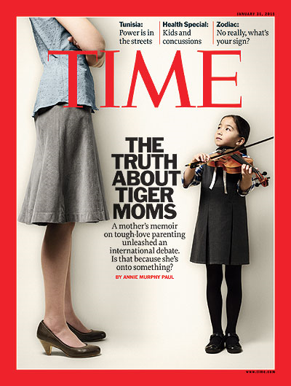
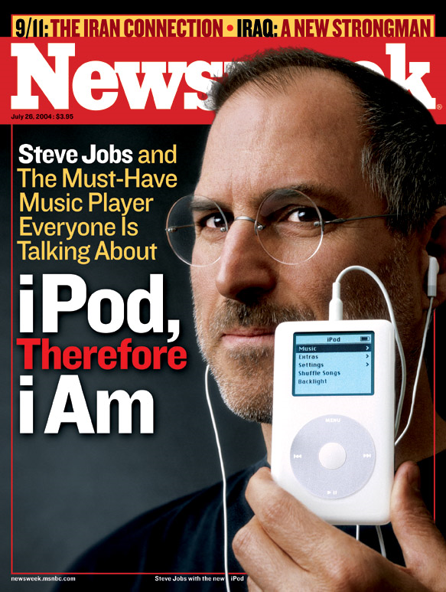
Popular usually refers to magazines such as
Image taken from http://www.time.com/time/covers/0,16641,1101110131,00.html
Image taken from http://static.seekingalpha.com/uploads/
2010/4/4/saupload_040717_cover.jpg

Slide 5
Peer Review
Peer review means the article has been reviewed by people that work in the same profession or field.
Evaluation of a person’s work by a group of experts before it is published to make sure it meets the necessary standards.
The purpose of peer review is to ensure that it is quality work.

Slide 6
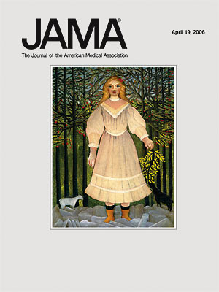
Scholarly usually refers to journals such as
Image taken from http://pubs.acs.org/
action/showLargeCover?issue=33036239
Image taken from http://jama.ama-assn.org/content/
295/15/1860.full

Slide 7
Summing Up
Both scholarly and popular articles can be used in research, but be aware of the characteristics and quality of each.

Slide 8
Books and articles are assigned words to describe their contents. These words are called subject headings.
Subject headings can also be known as descriptors, controlled vocabulary, or subjects.

Slide 9
These terms can be very useful for finding similar information on your research question.
They can help you identify other keywords so you can do a better search.

Slide 10
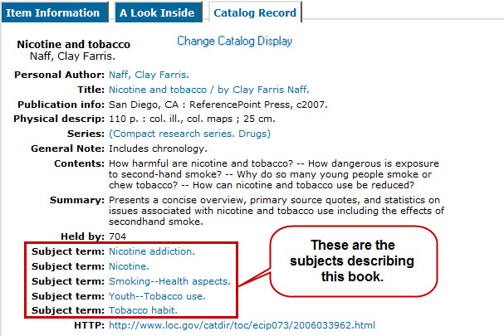

Slide 11
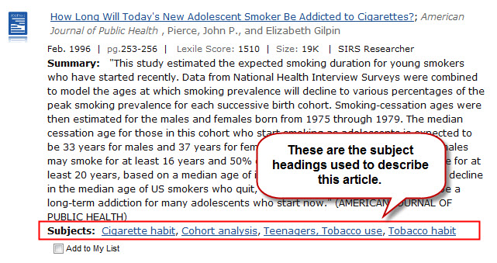

Slide 12
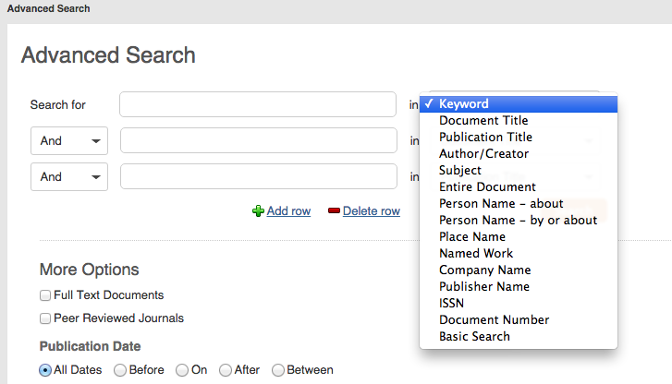
To use subject headings effectively, it is best to start with a keyword search. Find a book or article using the keywords from your research question.
KEYWORD
BOOLEAN

Slide 13
Keep in mind that catalogs and article databases may use different descriptors for different terms. One database might use the term movie, while another might use the term motion picture. To determine which term is used, do a keyword search and look at the subjects listed.

Slide 14
Quotation Marks and Truncation
In library catalogs and article databases, the two most helpful advanced search techniques are:
Quotation Marks
Truncation or Wild Card

Slide 15
Quotation Marks
Quotation marks are used around phrases. By using quotations marks, you are telling the computer to only bring back pages with the terms you typed in the exact order you typed them.
Example:
“health care reform”
instead of
health AND care AND reform
Notes:
Put example in color and have “health care reform” come in and then health and care and reform appear later.

Slide 16
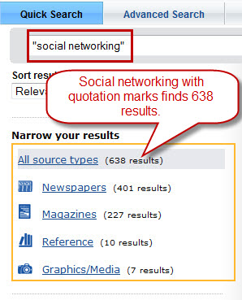
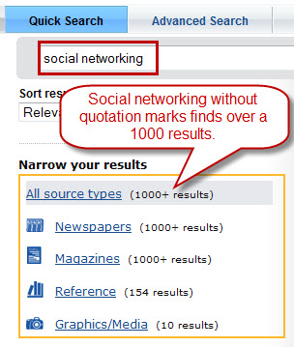
For example, if you are interested in finding information on social networking, it is best to search for “social networking” in quotation marks. Otherwise, the computer might search for social AND networking and find many more irrelevant results.

Slide 17
Truncation
Truncation means to chop off. When you truncate you chop off the end of the word, so the computer can search for multiple endings.
For example, your research question includes the keyword education. You can truncate education, so that the computer will find all of the word ending variations.
Educat* will find:
Education
Educate
Educated
Educating
Notes:
Animated gif would be great here.

Slide 18
The three Boolean operators are:
AND
OR
NOT
Boolean operators are used to expand or limit the number of results in a search.

Slide 19
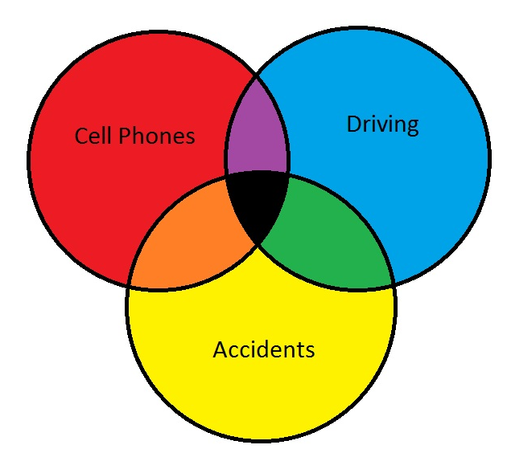
Diagrams visually explain how Boolean operators work.
Use Boolean operators to connect and search for the keywords found in your research question.

Slide 20
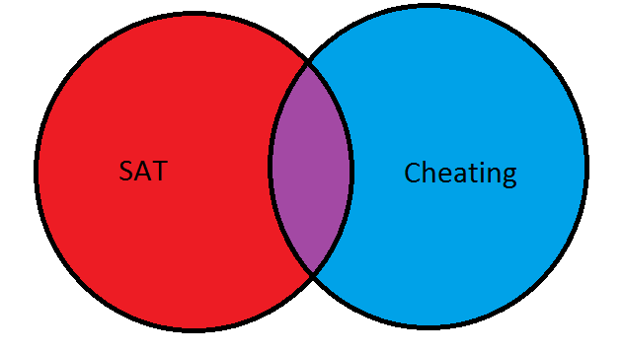
AND narrows your search. Use AND when you want your results to include all terms .
Only records with both terms will be found (the purple area).

Slide 21
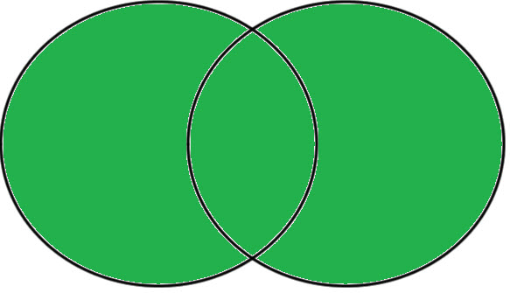
OR broadens your search. Use OR when searching synonyms and closely related keywords. OR will find results with one term or the other or both (the entire green area).
ACT
SAT
Notes:
The entire image should be highlighted.

Slide 22
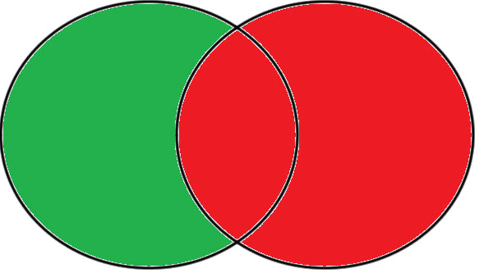
NOT narrows your search. Use NOT when you want to exclude a keyword from your search. Cheating NOT Test will find results with the word Cheating, but will exclude any results with the word Test.
Cheating
Test
Only records with the word cheating that do not include the word test
will be found (the green area).
Notes:
Here just the left hand side should be shown.

Slide 23
Boolean operators are an effective tool when searching article databases, library catalogs, and search engines.
Summing Up
AND narrows your search
OR broadens your search
NOT narrows your search

Slide 24
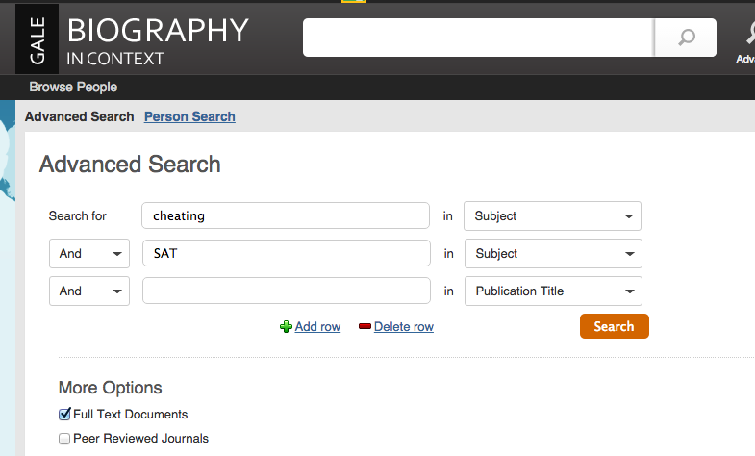
For example, GALE Biography uses them to perform advanced searches.
Here the AND Boolean Operator is being used to find articles that deal with both cheating and SAT.

Slide 25
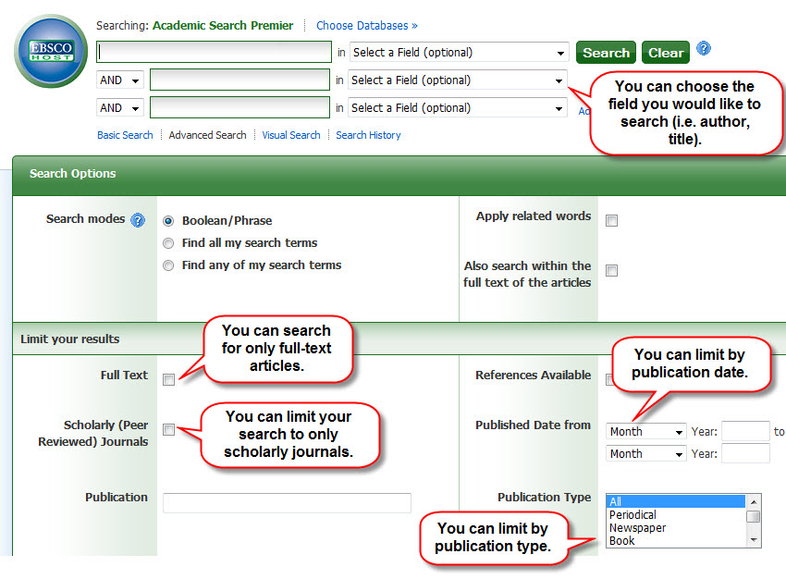
To search more precisely in article databases, you can use their advanced search screens.
This is the advanced search screen for the Academic Search Premier database.
Notes:
Show a screen from EBSCO the same as done for Google Advanced search with arrows and bubbles. Be sure to include full text option. Crop as necessary and make print larger, using more than one page if necessary.

Slide 26
Advanced Search Techniques for Web Searching
Using advanced search techniques when searching the web is even more important because you are sifting through so much information.
Some of the techniques used for searching the web versus library catalogs and article databases are different.

Slide 27
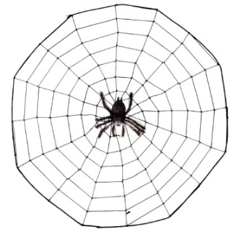
Web Searching Advanced Search Techniques
Use quotation marks to search for phrases
Use the minus (-) symbol in front of a word to exclude it
Use the advanced search screen to help refine your search
Be very specific
Search in appropriate domains (.gov, .com, .edu, .org)

Slide 28
Minus Symbol (-)
Sometimes when searching the web, the computer displays lots of results that are not on your topic.
For example, you want to find information on laser surgery, but most of the search results are pulling up LASIK. To remove these hits, search for: “laser surgery” -LASIK

Slide 29
Advanced Search Screen
Like article databases, most search engines have an advanced search screen. This screen offers many options to help you refine your search.

Slide 30
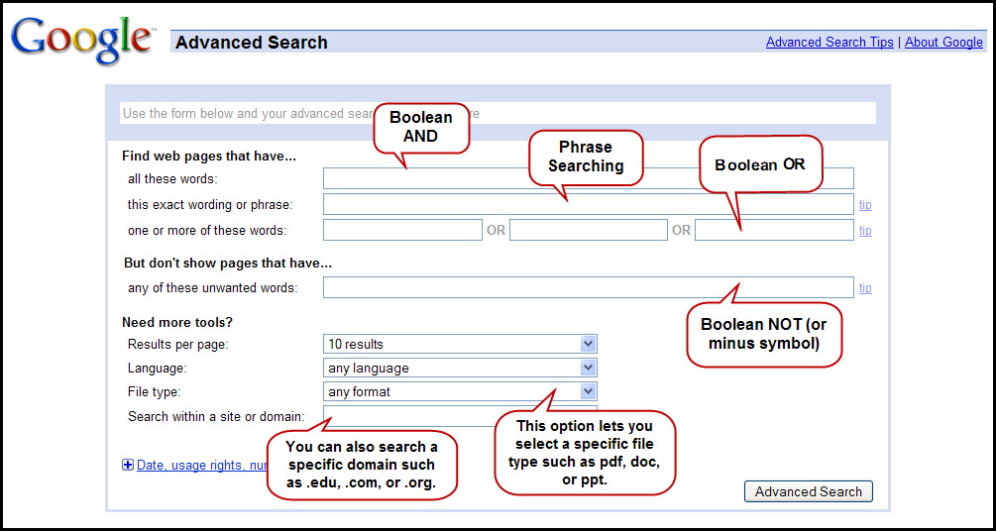
Google’s Advanced Search Screen

Slide 31
Evaluation
Search Engines: no one owns or controls the Internet, information does not go through a review process. Anyone can publish an opinion regardless of authority, education or experience with the subject. Web pages should be carefully evaluated for accuracy and reliability.
C.R.A.A.P. is an easy device, or mnemonic, to help you remember the following evaluation criteria:
C - Currency
R – Relevancy
A - Accuracy
A - Authority
P - Purpose

Slide 32
JHS Library
JHS High School- jhs.canyonsdistrict.org
Webpath = Database of website
Several databases searched all at once through library catalog

Slide 33
Assistance with revising the original HeLIOS Microsoft PowerPoint slides used for the HeLIOS Teaching Powerpoints and as the basis for the comic HeLIOS tutorial was provided by:
Joanne Christensen
Elayne Finlinson
Sarah Herron
Fawn Morgan

